Slide 1
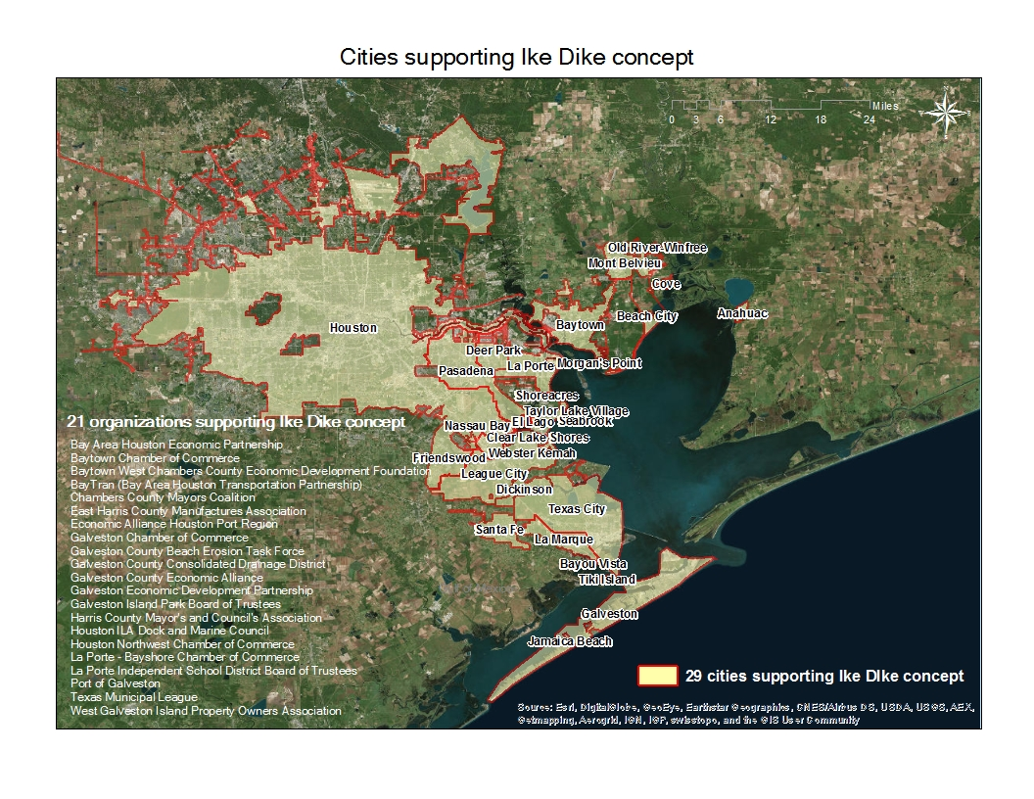

Slide 2
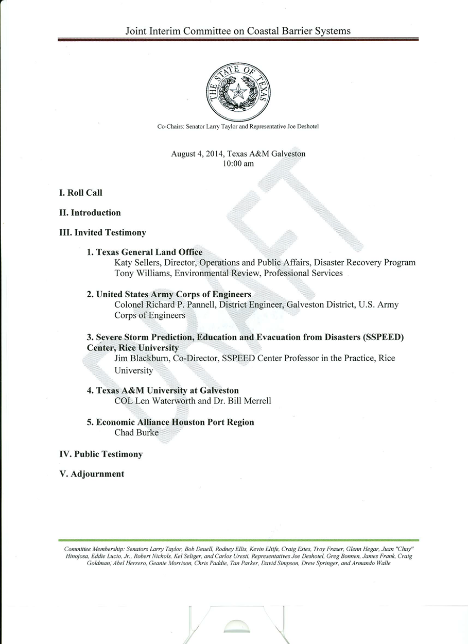

Slide 3
Texas Delegation to The Netherlands
4 Mayor’s
4 Texas State Representatives
2 Texas State Senator
2 Houston/Galveston City Council
43 Total in Delegation

